Slide 1
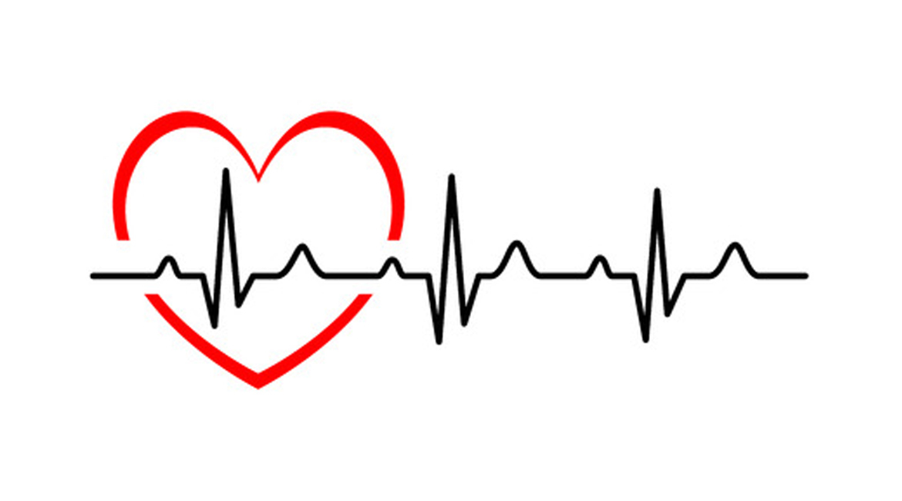
Heart Failure Mortality Prediction
By:
Avin Jabbar, Peagan Mitchell, Lilia Nassif, Kishan Patel

Slide 2
Data
Faisalabad Institute of Cardiology and at the Allied Hospital in Faisalabad (Punjab, Pakistan)
April-Dec 2015
299 Patients in the sample.
Machine learning can predict survival of patients with heart failure from serum creatinine and ejection fraction alone
Davide Chicco & Giuseppe Jurman
https://bmcmedinformdecismak.biomedcentral.com/articles/10.1186/s12911-020-1023-5

Slide 3
Data: Patient’s EMR
Age
Sex
Anemia
Hypertension
Diabetes
Smoking Hx
Ejection Fraction(EF)
Creatine Phosphokinase
Serum Creatinine
Serum Sodium
Death Event

Slide 4
Sex and Age Distribution: Deaths
Deaths:
F- 34
M- 62
Avg Age- 65yo
Median Age- 65yo
Total Deaths: 96
32% of 299 People died.

Slide 5
Sex and Age Distribution: Survival
Survival:
F- 71
M- 132
Avg Age- 59yo
Median- 60yo
Total Survived: 203
68% of 299 People Survived

Slide 6
-Heart failure death is more likely to occur >60 year olds

Slide 7
Anemia- Decrease of red blood cells or hemoglobin= Less O2 supply to the heart.
Death: 46 people; 47%
Survived: 83 People; 41%
Total Deaths: 96
Total Survived: 203

Slide 8
Hypertension- Damages your arteries by making them less elastic, which decreases the flow of blood and oxygen to your heart and leads to heart disease
Death: 39 People; 41%
Survival: 66 People; 33%
Total Deaths: 96
Total Survived: 203

Slide 9
Diabetes- High blood glucose from diabetes can damage your blood vessels and the nerves that control your heart and blood vessels.
Death: 40 people; 42%
Survival: 85 People; 42%
Possible factors contradicting classical assumptions:
-Time span of having diabetes and keeping it under control.
Total Deaths: 96
Total Survived: 203

Slide 10
Positive Smoking Hx- Chemicals in cigarette smoke cause the blood to thicken and form clots inside veins and arteries.
Death: 30 people; 31%
Survival: 66 People; 33%
Possible factors contradicting classical assumptions:
-Frequency and span of smoking.
Total Deaths: 96
Total Survived: 203

Slide 11
Ejection Fraction: Percentage of blood leaving the heart to the body
Normal EF- 50-70%
Avg EF Survived: 40%
Avg EF Death: 33%
EF<40% = higher chance of dying from heart failure.

Slide 12
Creatine phosphokinase: Enzyme. When the total CPK level is very high, it most often means there has been injury or stress to muscle tissue, the heart, or the brain
Normal: 10 to 120 micrograms per liter (mcg/L)
Although all the values were above the normal range; People who died had higher values than survival. Also, CPK could be high due to other tissue damage.
Avg CPK Death: 670 mcg/L
Ave CPK Survival: 540 mcg/L

Slide 13
Serum Creatinine: Levels indicative of renal insufficiency owing to chronic reductions of renal blood flow from reduced cardiac output
Normal Range: 0.74 to 1.35 mg/dL
Death events = Higher Serum Creatinine
Avg Death SC: 1.8 mg/dL
Avg Survival SC: 1.18 mg/dL

Slide 14
Serum Sodium: Low sodium lvls caused by the hormone Arginine vasopressin (AVP) which increases free-water reabsorption in the renal collecting ducts, increasing blood volume and diluting plasma sodium concentrations. AVP LVLs increase with heart failure
Normal Range: 135 and 145 (mEq/L)
Avg SS Death: 135 mEq/L
Avg SS Survival: 137 mEq/L

Slide 15
Summary
Heart failure death is more likely to occur >60 year olds
Men are higher risk than women.
Excellent and reliable qualifiers to predict heart failure mortality:
EF, Serum Creatinine
Good qualifiers:
Age, Serum Sodium, HTN, Anemia, Sex, CPK
Decent qualifiers:
Positive Smoking History, Diabetes

Slide 16
Summary and Data
Row Labels | Count of age | Average of age | Sum of anaemia | Average of anaemia | Sum of high_blood_pressure | Average of high_blood_pressure | Sum of diabetes | Average of diabetes | Sum of smoking | Average of smoking | Average of ejection_fraction
Died | 96 | 65.21528125 | 46 | 0.479166667 | 39 | 0.40625 | 40 | 0.416666667 | 30 | 0.3125 | 33.46875
Female | 34 | 62.17647059 | 20 | 0.588235294 | 17 | 0.5 | 20 | 0.588235294 | 3 | 0.088235294 | 37.52941176
Male | 62 | 66.88172581 | 26 | 0.419354839 | 22 | 0.35483871 | 20 | 0.322580645 | 27 | 0.435483871 | 31.24193548
Survived | 203 | 58.7619064 | 83 | 0.408866995 | 66 | 0.325123153 | 85 | 0.418719212 | 66 | 0.325123153 | 40.26600985
Female | 71 | 58.62911268 | 32 | 0.450704225 | 27 | 0.38028169 | 35 | 0.492957746 | 1 | 0.014084507 | 41.87323944
Male | 132 | 58.83333333 | 51 | 0.386363636 | 39 | 0.295454545 | 50 | 0.378787879 | 65 | 0.492424242 | 39.40151515
(blank)
(blank)
Grand Total | 299 | 60.83389298 | 129 | 0.431438127 | 105 | 0.351170569 | 125 | 0.418060201 | 96 | 0.321070234 | 38.08361204

Slide 17
Summary and Data
Row Labels | Average of creatinine_phosphokinase | Average of serum_creatinine | Average of serum_sodium
Died | 670.1979167 | 1.835833333 | 135.375
Female | 507.6764706 | 1.945882353 | 135.4705882
Male | 759.3225806 | 1.775483871 | 135.3225806
Survived | 540.0541872 | 1.184876847 | 137.2167488
Female | 461.9859155 | 1.115070423 | 137.4225352
Male | 582.0454545 | 1.222424242 | 137.1060606
(blank)
(blank)
Grand Total | 581.8394649 | 1.393879599 | 136.6254181

